Slide 1
Starting from Dataset
Characteristic
Low-dimension
Large-size
1
Notes:
Here comes to the data analytic part As seen from EDA, we have large dataset with only a few features

Slide 2
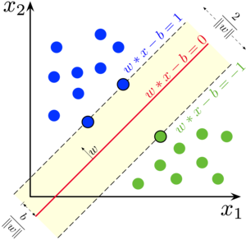
SVM
Able to capture the nonlinear structure by kernel transformation
Hyperparameters chosen:
C : 0.01 (due to time complexity concerns)
Kernel: Gaussian
Gamma:0.5
Resilient to outliers
Require feature scaling, might require label balancing as well
2
Notes:
Here the first model we try is SVM.
It has the merit of capturing nonlinearity, also resilient to outliers.
Besides, it is distanced based method require feature scaling and perhaps label balancing,
so we choose small C due to time complexity concerns and gaussian kernel with gamma 0.5

Slide 3
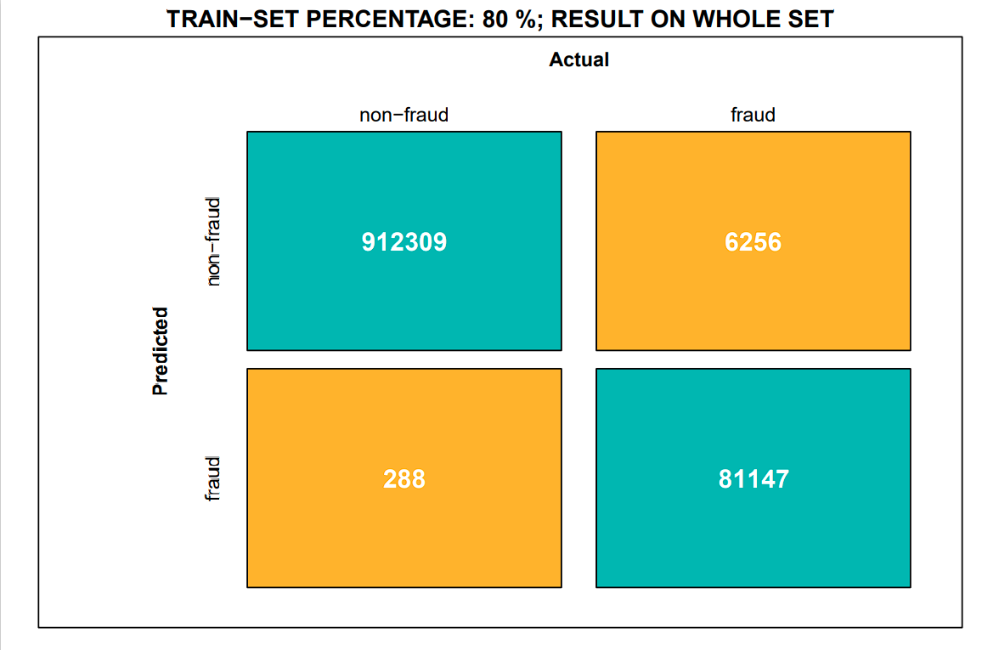
SVM RESULT – without downsampling
Precision
Recall
F1
Accuracy
Kappa
0.996
0.928
0.961
0.993
0.958
3
Notes:
We first use the whole unbalanced dataset, split training set by the given proportion and build the model based on that, and evaluated on the whole set.
As seen results are good, except recall still have space for improvement

Slide 4

SVM RESULT – without downsampling
Precision
Recall
F1
Accuracy
Kappa
0.997
0.892
0.941
0.99
0.936
4
Notes:
As we shrink the training set proportion, the performance gets slightly worse.

Slide 5
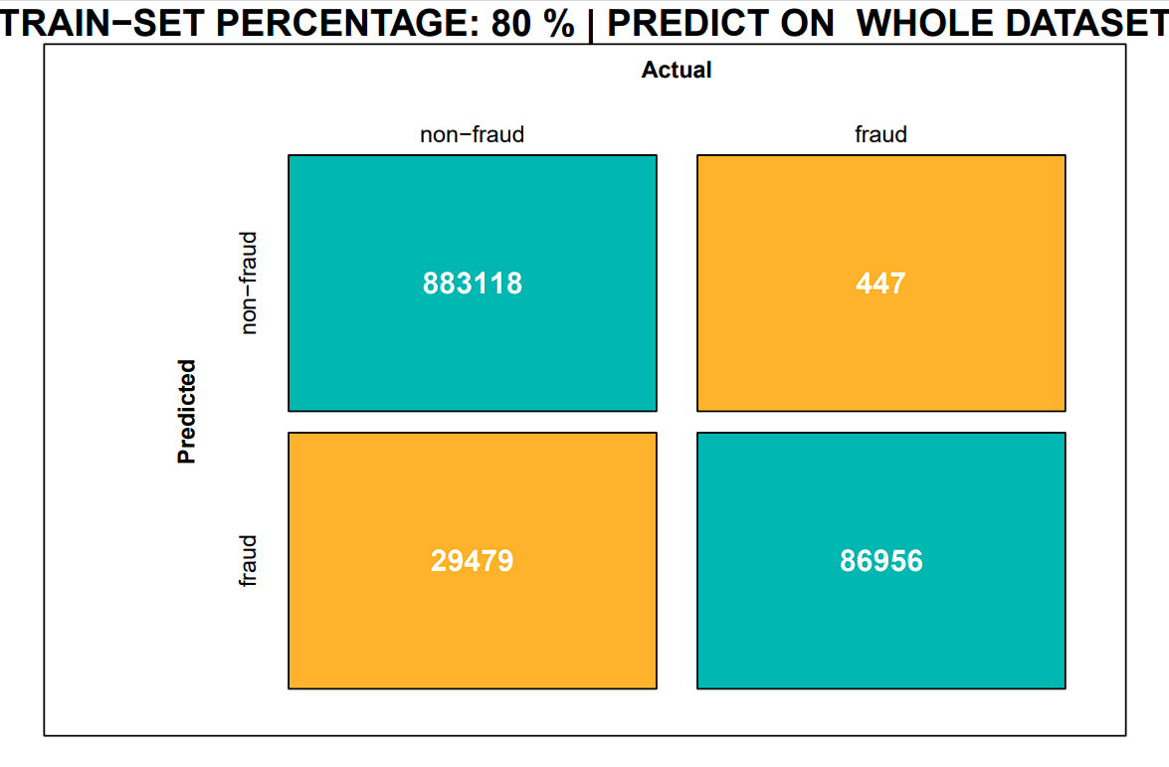
SVM RESULT – with downsampling
Precision
Recall
F1
Accuracy
Kappa
0.747
0.995
0.853
0.97
0.837
5
Notes:
We rebuild the model, by first downsampling the data to balance the labels, split from this downsampled set to get training data and build the model, still evaluate on the whole set.
Here we see the trade off between label balancing and downsampling, as we have higher recall, meaning the model is more capable of capturing fraud cases, but also much lower recall, meaning the model gets too arrestee that lots of normal cases are classified as fraud.

Slide 6
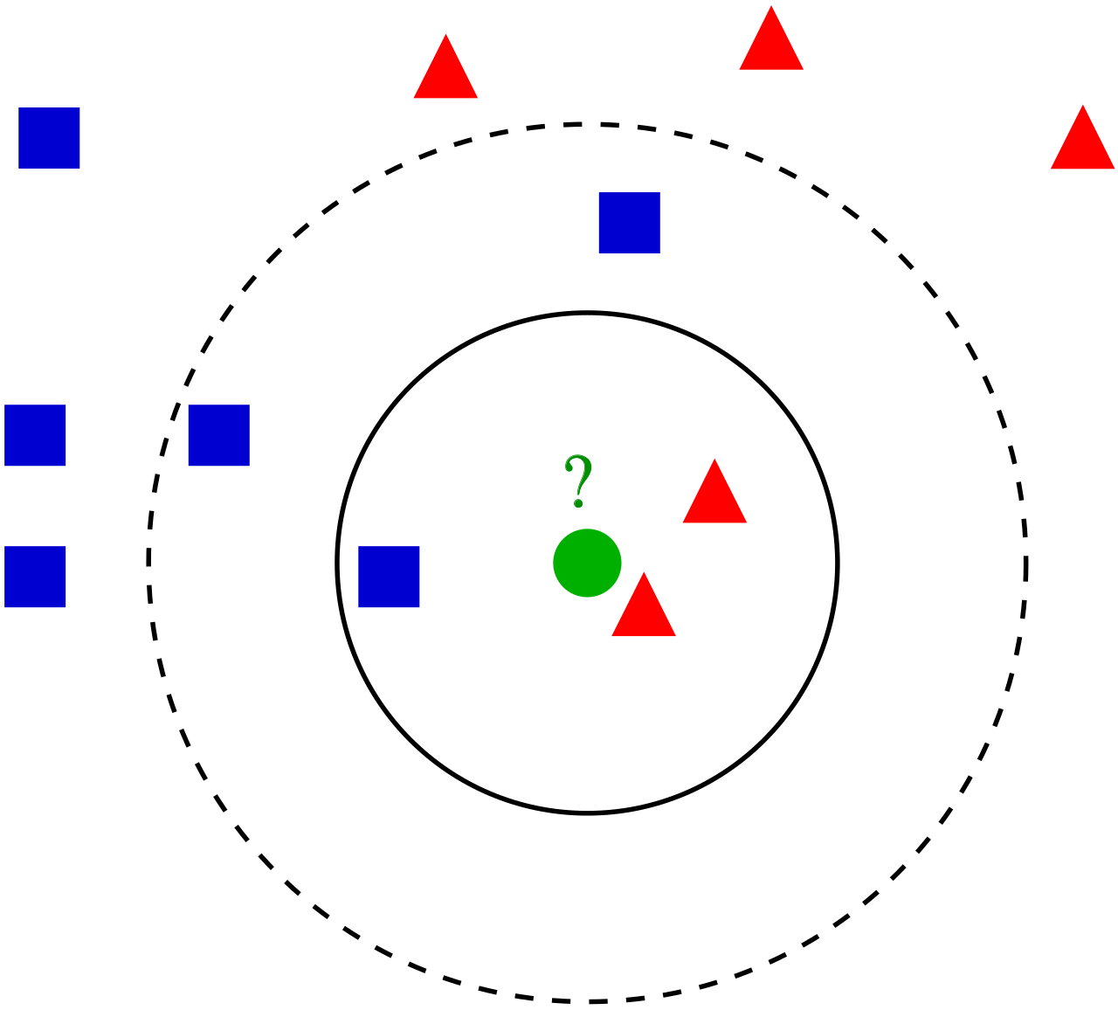
K-NN
Quite high accuracy on clustering works
Performs better on low-dimension dataset
6
Notes:
However, one important assumption about svm is that data is separable by a hyperplane or a boundary which might not hold true in practice, hence we think knn might be a better alternative as it trains faster, its more suitable for clustering work, also perform better on low dimensional dataset.

Slide 7
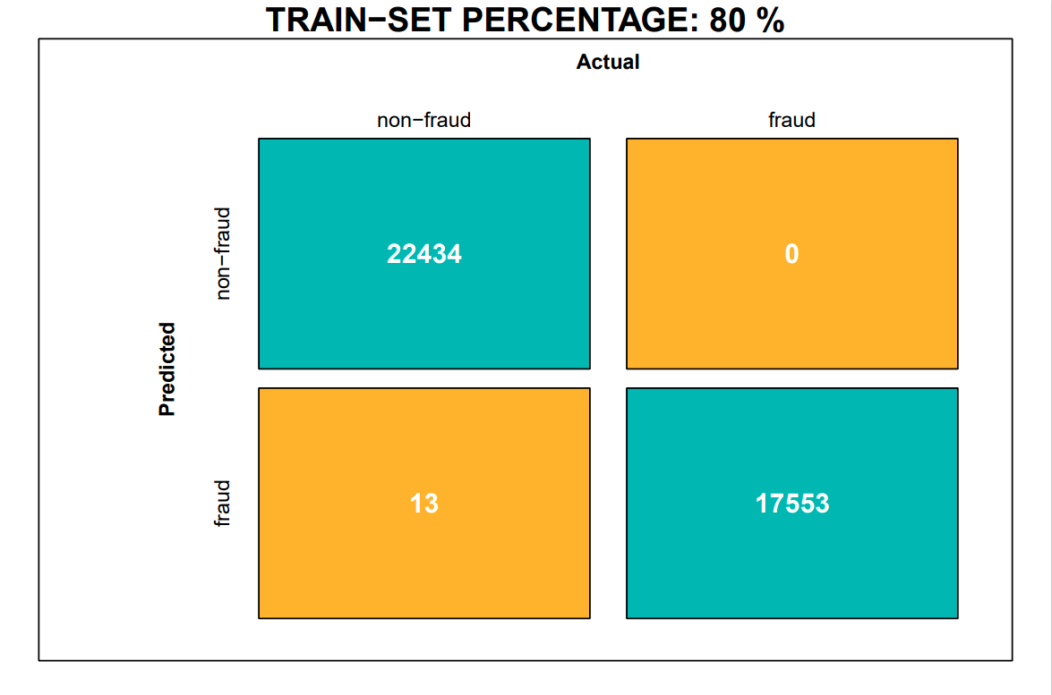
K-NN RESULT
Precision
Recall
F1
Accuracy
Kappa
0.999
1
1
1
0.999
7
Notes:
Like before we rescale and downsample the dataset, and then do the train test split, and here evaluated on the test size, results is quite satisfactory, at least better than svm.

Slide 8
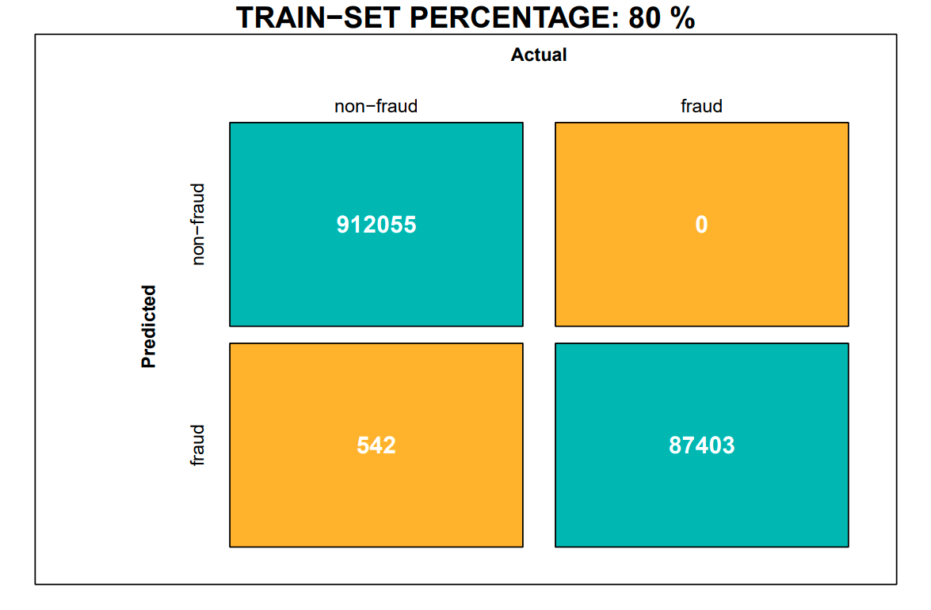
K-NN RESULT
Precision
Recall
F1
Accuracy
Kappa
0.994
1
0.997
0.999
0.997
8
Notes:
Here we evaluate it on the whole set, result still good except precision drops down a little bit.

Slide 9

K-NN RESULT
Precision
Recall
F1
Accuracy
Kappa
0.994
1
0.997
0.999
0.997
9
Notes:
Even if we push down the training proportion, result does not get worse except only a few more false positive.
We can see knn already gives us fairly good prediction performance. However if we want to explore more about each feature importance and their inductiveness, we should try tree-based method instead.

Slide 10
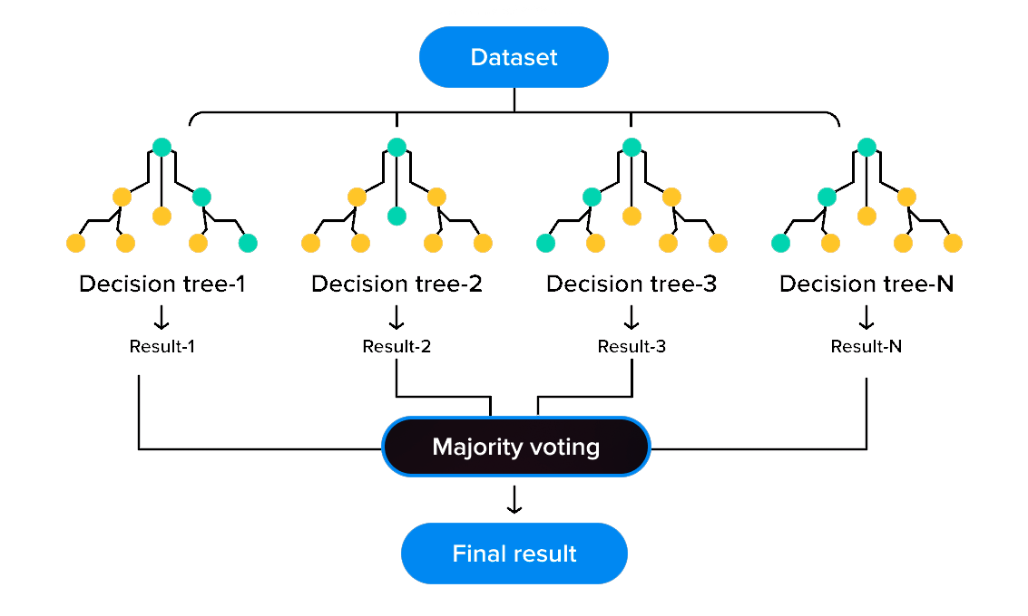
Tree Based Model – Random Forest
10
Notes:
One widely used model is random forest, which bootstrapping instances to build multiple decision trees and vote for the result. Thanks to some characteristics of this model, we do not need to do scaling or balancing sampling to the dataset. And as we thought, the model performs amazingly well.

Slide 11

RANDOM FOREST RESULT
Precision
Recall
F1
Accuracy
Kappa
1
1
1
1
1
11
Notes:
The performance is nearly perfect, but what about the problem we just mentioned? Let’s try to provide only a small part of data and see what happens:

Slide 12

RANDOM FOREST RESULT – 2
Precision
Recall
F1
Accuracy
Kappa
1
1
1
1
1
12
Notes:
Fine, still amazing. Because random forest is not sensitive to the missing part of the data, it can extract valuable features from few instances. Now we have a model with high accuracy, what do we need next?

Slide 13
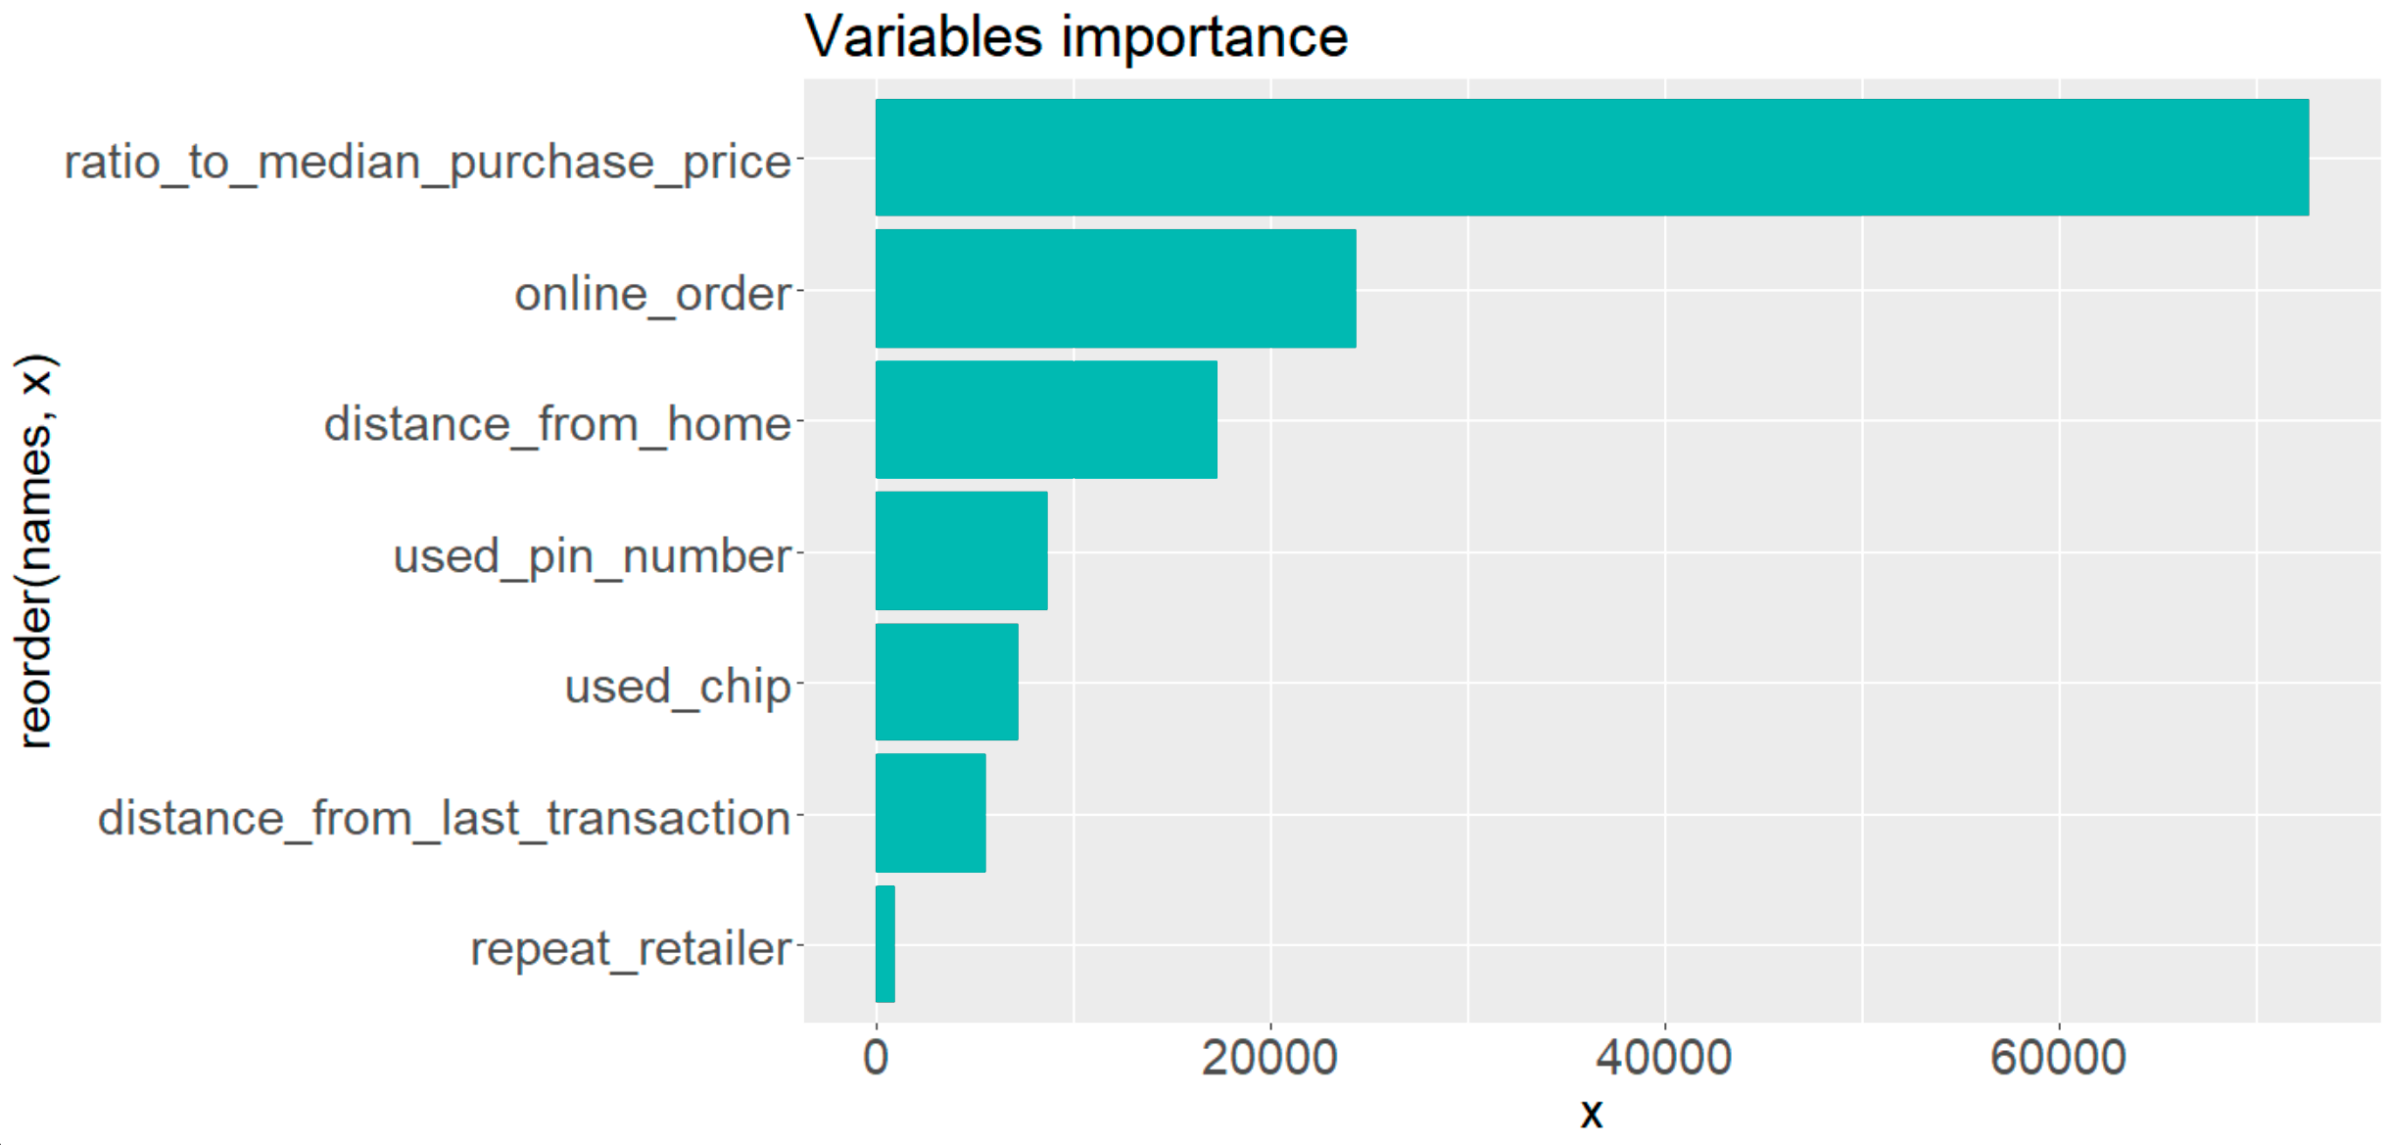
ATTRIBUTES IMPORTANCE
13
Notes:
Check the attributes importance exported from the model, we can verify the correlation of the variables mentioned in the EDA process. But how do we explain the attributes importance?

Slide 14
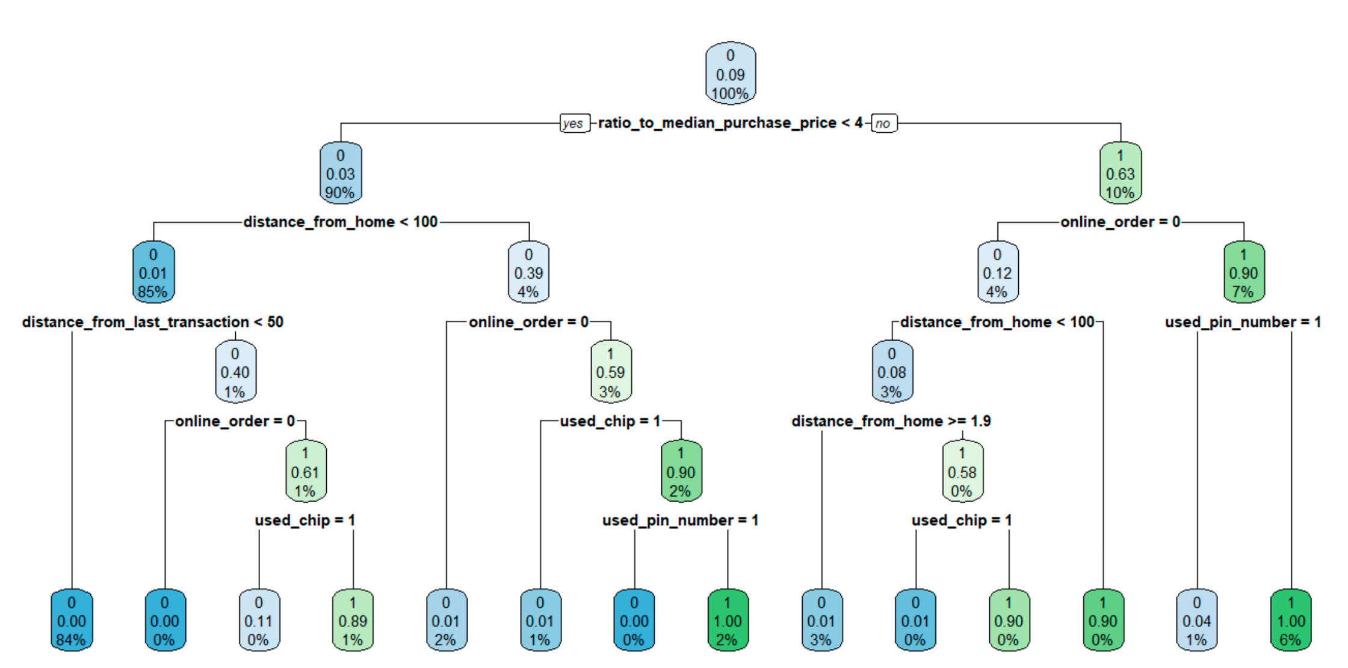
FRAUD ANALYSIS
14
Notes:
We then used decision tree - an algorithm with high interpretability - to help us explore the relationship between these attributes and the fraud records. In another words - how do these attributes effect the results of classification. To simplify this diagram a bit, we get this.

Slide 15
FRAUD ANALYSIS
ratio_to_median_purchase_price | online_order | distance_ from_home | used_pin_number | used_chip | distance_from_last_transaction
≥4 | 0 | <1.9 | X | 0 | X
≥4 | 0 | ≥100 | X | X | X
≥4 | 1 | X | 0 | X | X
＜4 | 1 | ≥100 | 0 | 0 | X
＜4 | 1 | <100 | X | 0 | ≥50
15
Notes:
Summarize the five rules to fraud cases, they should be merchant abuse, stealing, deception, leaked account, leaked pin number. Then we can use these rules to give our customers some advices and to add some restrictions in our system to decrease the fraud rate.

